Slide 1

AI and Art
Sebastian Rist – CSIT 100

Slide 2

ART
“The expression or application of human creative skill and imagination.”
ARTIFICIAL INTELLIGENCE (AI)
“The simulation of human intelligence in machines.”
AI ART
“The simulation of the expression or application of human skill and imagination in machines.”
Notes:
Despite this, we as humans have created programs that attempt to replicate human art with computers. Many call these programs AI art generators and call the produced image art. Many, however, disagree with this and call them image generators. These AI generated images have become intertwined with both our use of computers and society

Slide 3
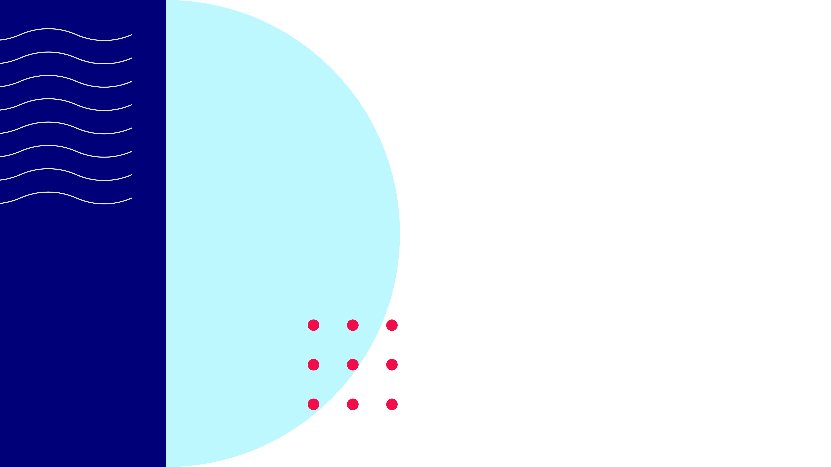
GAN
General Adversarial Network
Generates images based on the prompt given by the user, as well as provided data
Attempts to discriminate between what is from the data set and what was created by the generator
This the system trains itself to improve how it generates new instances of the provided data and in a way that adheres to the prompt
Notes:
The main method of having computers generate art is the use of a general adversarial network or GAN. This system essentially generates images based on the prompt given by the user, as well as provided data. The system then attempts to discriminate between what is from the data set and what was created by the generator. By doing this the system trains itself to improve how it generates new instances of the provided data and in a way that adheres to the prompt.

Slide 4

CNN
Convolutional Neural Networks
Trained with certain images .
Perceive patterns within an image and applies the patterns to the image
Notes:
Convolutional neural networks or CNNs perceive patterns and makes them more prominent. This is done by training the program with certain images. The program then uses these images to find patterns and applies them to another image. An example is a program called DeepDream which does exactly that. In one instance it put dog faces all over the Mona Lisa.

Slide 5

NST
Turns an image from one style to another
Neural Style Transfer
Notes:
A picture can be turned into a cartoon image, or a realistic piece of art could be turned into an impressionist piece.

Slide 6
Evolution of AI in Art
1800’S - NOW

Slide 7
Timeline
1800 (approx.) – Maillardet’s Automation
1973 – AARON
2013 – The Painting Fool
21st Century – Societal integration of computer-generated images
Notes:
Maillardet’s Automation – an automated machine, built by Henri Maillardet, which could produce three poems and four drawings. This, however, is considered automated art and although it was a machine producing the art it was not being created by artificial intelligence.
AARON – Harold Cohen created a program which is cited as creating the first real computer-generated image. used a black marker to create drawings on paper. AARON worked inside a set of rules defined by Cohen. Cohen would set forms of people and items that AARON used to create its images. Eventually in 1995, AARON started working in color as well. As AARON was improved Cohen switched programming languages from C to LISP.
The Painting Fool - Simon Colton created a program called the Painting Fool. This program creates pieces based on images and emotions because Colton believed that true art had to be creative and imaginative. At this point other programmers, musicians, and artists such as Google and Taryn Southern began using AI to generate images.
Now - AI generated images has become very widespread. It has sold for thousands of dollars and won art competitions over human individual’s art. Image generators have become intertwined in our digital society with apps and websites open for the public to use to generate images based on key words. Computer generated images are even available through social media apps such as Instagram.

Slide 8
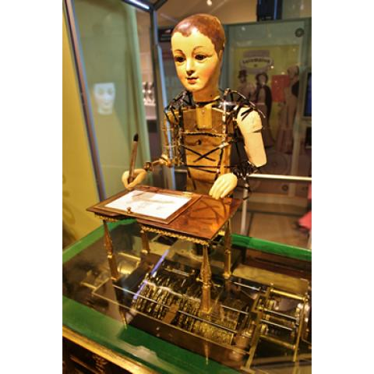
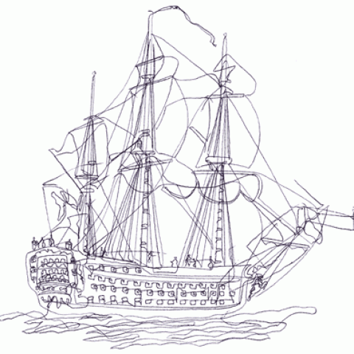
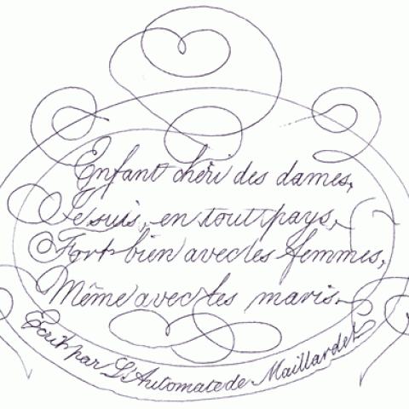
Maillardet’s Automation
Created by Henri Maillardet
Produced Images and Writings
Notes:
Maillardet’s Automation – an automated machine, built by Henri Maillardet, which could produce three poems and four drawings. This, however, is considered automated art and although it was a machine producing the art it was not being created by artificial intelligence.

Slide 9
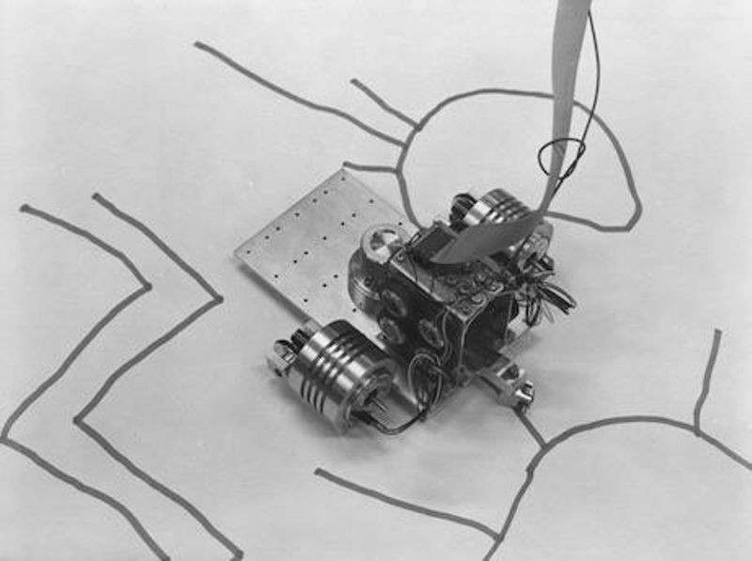
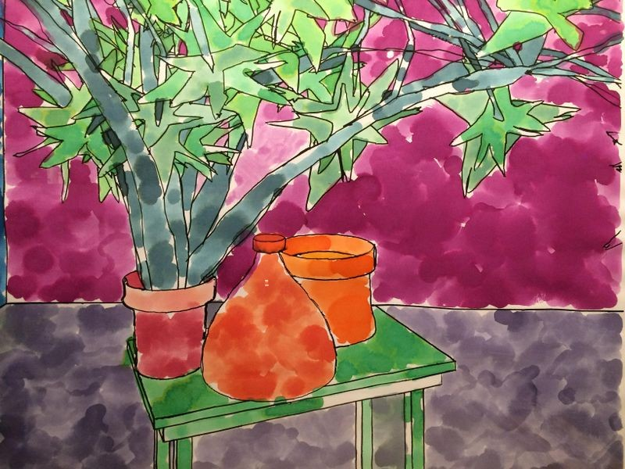
AARON
Created by Harold Cohen
Cited as the first image generator
Used a black marker to create drawings
Expanded to color in 1995
Started program language in C
Later changed to LISP
Notes:
AARON – Harold Cohen created a program which is cited as creating the first real computer-generated image. used a black marker to create drawings on paper. AARON worked inside a set of rules defined by Cohen. Cohen would set forms of people and items that AARON used to create its images. Eventually in 1995, AARON started working in color as well. As AARON was improved Cohen switched programming languages from C to LISP.

Slide 10
Present Day
Integration of AI into Society
In the 21st century AI generated images has become very widespread. It has sold for thousands of dollars and won art competitions over human individual’s art. Image generators have become intertwined in our digital society with apps and websites open for the public to use to generate images based on key words. Computer generated images are even available through social media apps such as Instagram.

Slide 11
How AI Art Affects the Public
Pros and Cons
Notes:
Many argue that AI generated images allow individuals to express their creativity without needing to have the skills that would be otherwise necessary to do so. However, many also argue that using AI generators takes away from the authenticity and human aspect of art, it is for this very reason that many refuse to call this process artistic.

Slide 12
Pros
Time
Convenience
Self Expression without Skill
Cost

Slide 13
Cons
Lack of Skill
Anatomy, coloring, shading, etc
Less Control
White-Washing
Notes:
Along with this proposed lack of authenticity there is the aforementioned lack of skill. Many of these images generated by computers do simply lack the skill of other artists. A lot of the anatomy of these images is off as well as the physics, shading, and accuracy to the prompt. There is less control and personalization over the final product than working with a human artist as you are only putting in a few key words. It is impossible to create the same image twice. If there is a character or scene that one wants to recreate from one image to another it is almost impossible to do so with computer generators.
There is another big issue many people run into when using AI generated images. When trying to use AI generators to produce images of people of color, many are finding that their features are being changed or that the image generators are not properly depicting features of POC. AI image generators will give them smaller noses, double eyelids, different hair textures, lighter skin, as well as change many other features.

Slide 14
How AI Art Affects Artists
Pros and Cons

Slide 15
Pros
Inspiration
Notes:
In a similar way, many artists, fashion designers, interior designers, and architects use computer generated art to spark their own creativity. These programs serve as inspiration for their own projects, helping them create their art.

Slide 16
Cons
Trained with Artist’s Art
Lack of Commissions
Revaluing of Art
Replacement

Slide 17

Overview
AI and Art
There are many ways in which AI image generators have evolved and come to impact both artists and individuals.
Notes:
Both positive and negative. I am interested to see how this technology will evolve and how it will continue to affect us all.

Slide 18
References
PowerPoint Template - Pastel Pattern Presentation Template (Free Sample) on Behance
Benney, Marnie, and Pete Kistler. “Artificial Intelligence Timeline [UPDATED 2020].” AIArtists.org, 2020, aiartists.org/ai-timeline-art.
Clarke, Madeline. “What Is an AI Art Generator? Features, Benefits and More.” TechRepublic, 13 Sept. 2023, www.techrepublic.com/article/what-is-ai-art-generator/#what-are-some-business-use-cases-of-ai-art-generators.
DeJausserand, Madyson. “Art Trend of 2022: How AI Art Emerged and Polarized the Art World.” My Modern Met, 7 Dec. 2022, mymodernmet.com/ai-art-2022/.
Garcia, Chris. “Harold Cohen and AARON—a 40-Year Collaboration.” Computer History Museum, 23 Aug. 2016, computerhistory.org/blog/harold-cohen-and-aaron-a-40-year-collaboration/.
Kan, Michael. “Artists Drop Twitter over Elon Musk’s Plan to Train His AI Project on Tweets.” PCMAG, 1 Aug. 2023, www.pcmag.com/news/artists-drop-twitter-over-elon-musks-plan-to-train-his-ai-project-on-tweets.

Slide 19
References (pg.2)
“Maillardet’s Automaton | the Franklin Institute.” Www.fi.edu, www.fi.edu/en/history-resources/automaton.
Mello-Klein, Cody. “Artificial Intelligence Is Here in Our Entertainment. What Does That Mean for the Future of the Arts?” News @ Northeastern, 9 Sept. 2022, news.northeastern.edu/2022/09/09/art-and-ai/.
Raya Bidshahri. “The Rise of AI Art—and What It Means for Human Creativity.” Singularity Hub, 17 June 2019, singularityhub.com/2019/06/17/the-rise-of-ai-art-and-what-it-means-for-human-creativity/.
Rea, Naomi. “How Did A.I. Art Evolve? Here’s a 5,000-Year Timeline of Artists Employing Artificial Intelligence, from the Ancient Inca to Modern-Day GANs.” Artnet News, 16 Dec. 2021, news.artnet.com/art-world/artificial-intelligence-art-history-2045520.
Small, Zachary. “Black Artists Say A.I. Shows Bias, with Algorithms Erasing Their History.” The New York Times, 4 July 2023, www.nytimes.com/2023/07/04/arts/design/black-artists-bias-ai.html.
Yup, Kayla. “What AI Art Means for Society, according to Yale Experts.” Yale Daily News, 23 Jan. 2023, yaledailynews.com/blog/2023/01/23/what-ai-art-means-for-society-according-to-yale-experts/.

